Slide 1
Great Wood centre manager: Carly Kew centre Chaplain: Patrick weld
SSE Outdoors

Slide 2
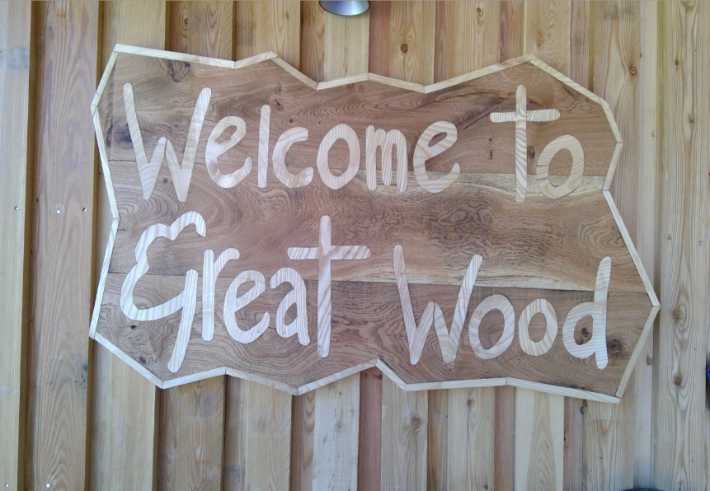
Welcome to great wood

Slide 3
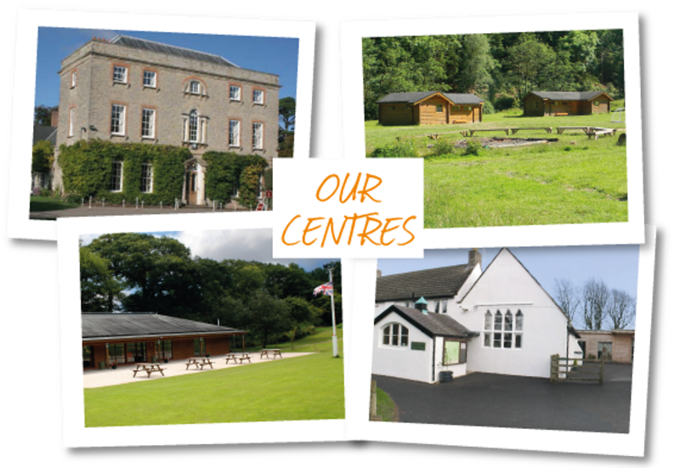
SSE Outdoors
SSE Outdoors is part of the County Council within the Education, Partnerships and Skills area of Children's services
There are four centres: Kilve Court, Great Wood, The Outdoor Centre, & Charterhouse​
Operating for over 60 years​
Great Wood is located in Ramscombe, at the foot of the Quantocks.
Providing residential courses, day courses, educational courses, conferences, DoE and much more… ​

Slide 4
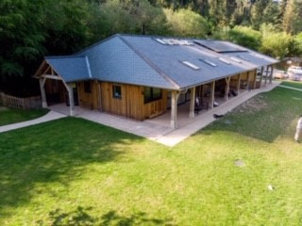
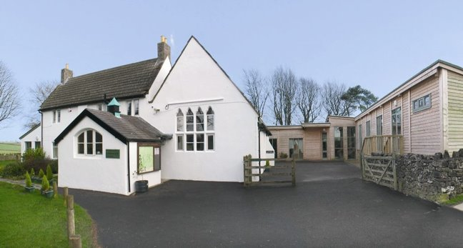
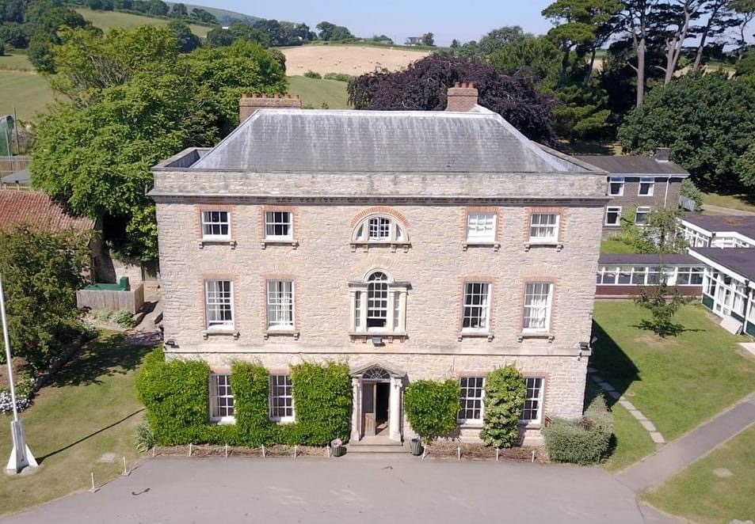
Our 4 centres

Slide 5
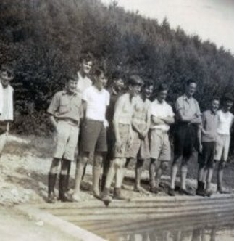
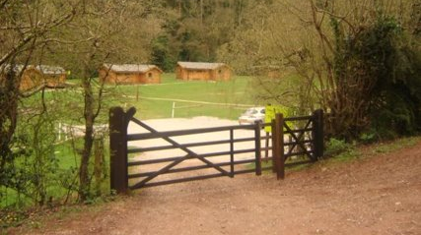
History
Great Wood camp is nestled in Great Wood, Ramscombe. The woods are managed by Forestry England, but the camp is privately owned by the Great Wood Trust. We have worked alongside the GWT for over 50 years. ​
The site was originally established by a Scout leader, John Inchley. In 1943 a few scouts pitched their tents above the farm in Adscombe. He liked it so much he persuaded Scripture Union to create a permanent camp for young people. It was put on the map in 1946. ​

Slide 6
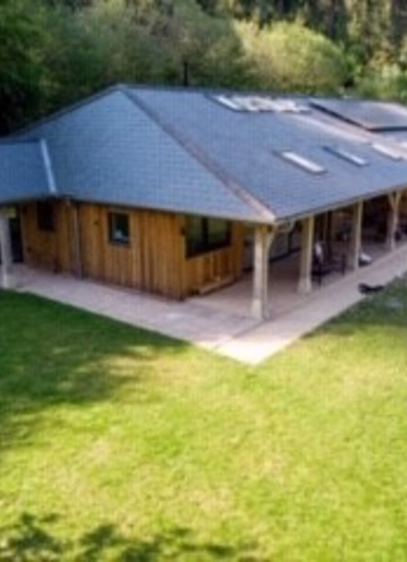
Why go on Camp?
Enjoyment ​& fun – you will have lots of it!
Personal Achievement​ - you will do things you didn’t think you could!
Confidence​ - you will grow in confidence with every new challenge
Social Awareness​ - sharing your cabin & looking out for each other
Environmental Awareness​ - you will learn new things
Life long Memories​ - when you're older, you will always remember camp
Health & Fitness​ - being in the outdoors and keeping busy all day long
Increased Motivation​ - wanting to try new things and being ready to do them
Mental wellbeing – being in the outdoors is great for this
Team building – working together to complete various challenges ​
Adventure​ - lots to had, if you're brave enough
Personal Responsibility ​- doing things for yourself

Slide 7
Security & Policies
To operate safely and efficiently, we …​
AALA license (Adventurous Activities Licensing Authority) ​
All staff are DBS checked​, Somerset County Council employees
NGB qualified staff (National Governing Body)​
Risk assessments & procedures for all activities, ​ grounds & buildings​
All cabins have keypad entry systems​ - you will be told your code once at camp
The site is fenced and gated
Centre staff identified with uniforms​
There are no wild animals at Great Wood that want to eat you!

Slide 8
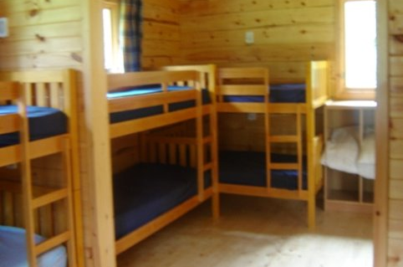
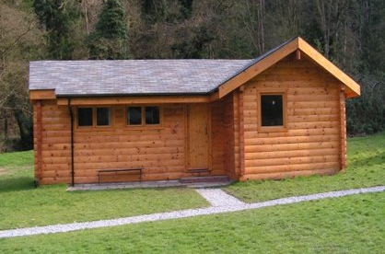
accommodation
Each cabin sleeps 4-10 students, 2 rooms of 4 & 1 room of 2
All rooms have their own sinks, mirrors, bedside lights and sockets
All cabins have en-suite bathrooms
Separate staff cabins or a staff room in each cabin with its own bathroom
Smoke detectors in each cabin, alarms & fire extinguishers
Keypad entry to all accommodation
Heating throughout all cabins
9 cabins in total

Slide 9
The most important bit…food!
BREAKFAST - rice krispies, corn flakes or Weetabix
Sausages, scrambled eggs, beans, toast / bacon, fried egg, beans & toast
Fruit juice or water to drink
LUNCH - A packed lunch – in your sandwich you can have, ham, cheese, jam, egg mayo or tuna mayo. You also get the best yoghurt in the world, a chocolate biscuit, crisps and fruit
DINNER - 2 choices, one of which is vegetarian and a yummy pudding! ​
BREAK TIMES - Squash or water, biscuits, fruit or cake ​
Dietary needs are catered for. If you know you don’t eat much, please don’t worry you can bring your own if that helps. We like to make sure everyone is always fed!

Slide 10
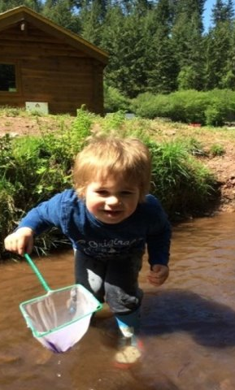
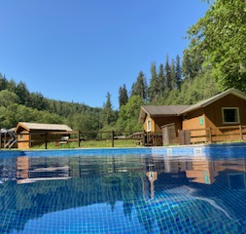
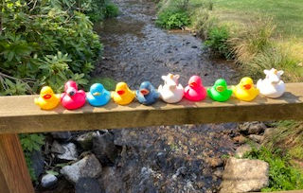
Activities
ORIENTEERING
DAM BUILDING​
SHELTER BUILDING​
CAMP FIRE​
WOOD COLLECTING​
ARCHERY​
JUMBLIES​
NIGHT LINE​
QUANTOCK ADVENTURE​
NIGHT WALK​
SWIMMING​
TEAM CHALLENGES​
TRACKING & TRAILING​
BEACH VISIT​
STREAM STUDY​
ROCKET DESIGN
ENVIRONMENTAL ART​
DUCK RACING​
ONE MATCH CHALLENGE​
BINGO​
ROCKET LAUNCHING
BOULDERING

Slide 11
A typical day
ARRIVAL DAY ​
Arrive, unpack, settle in, welcome talk and a fire drill. ​
DURING YOUR STAY ​
Wake up around 7:45am, breakfast is at 8:30am, morning activities, lunch, afternoon activities, evening meal, evening activities, bedtime. There are break times in the morning and afternoon.​
DEPARTURE DAY ​
Wake up and pack, move bags out of cabins, ​breakfast, last activity, lunch, goodbyes and depart.​

Slide 12
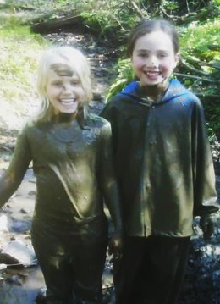
Helpful packing tips
You should be packing or own bag or at least helping!– when you pack your own bag to go home, you will be brilliant at it!
Make sure you have your names in all your clothes & footwear – this will help when you are packing, to come home
Only pack clothes that are ok to get wet & muddy – we don’t care if its old or a bit too small for you. We want you to enjoy yourself and not worry about your clothes or shoes!
Do not pack any electrical items – you will be so busy; you won't have time for them anyway
Lip balm, sunscreen, drinks bottle, book, pocket money, torch &​ cuddly toy – all recommended items to pack. ​​
A black bin bag – to put your wet muddy clothes in

Slide 13
Thank you for your time
Any questions?

