Slide 1
Kilve Court centre manager: Karl Watson
SSE Outdoors

Slide 2
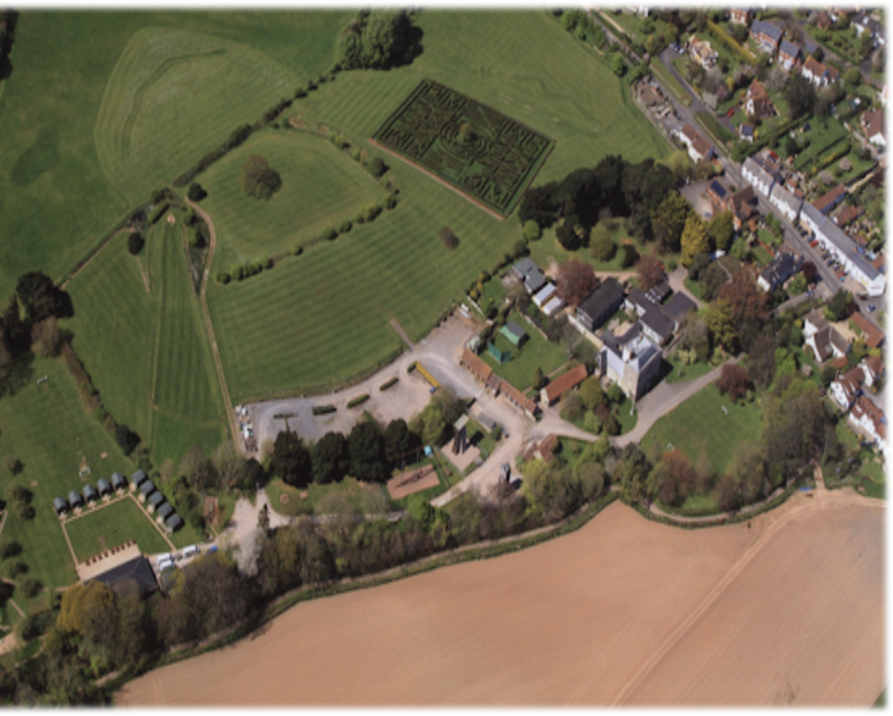
Welcome to Kilve Court

Slide 3
SSE Outdoors
Kilve Court
There are four centres: Kilve Court, Great Wood, The Outdoor Centre, & Charterhouse​
Operating for over 60 years​
Kilve Court is located in the village of Kilve, at the bottom of the Quantock Hills , between Bridgwater & Minehead​
Providing residential courses, day courses, educational courses, conferences, DoE and much more… ​
SSE Outdoors is part of the County Council within the Education, Partnerships and Skills area of Children's services

Slide 4
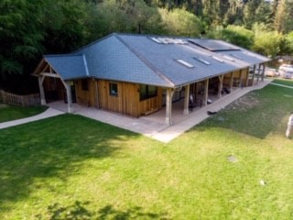
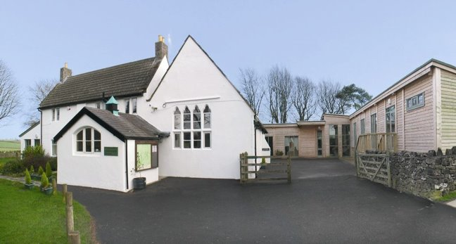
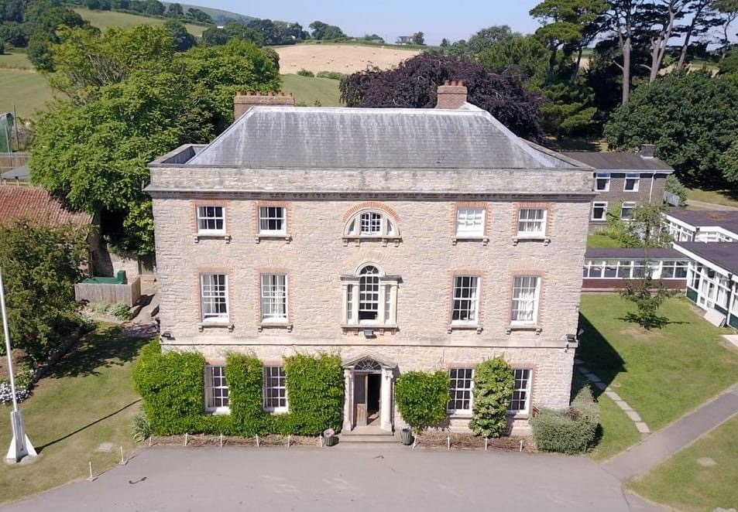
Our four centres

Slide 5
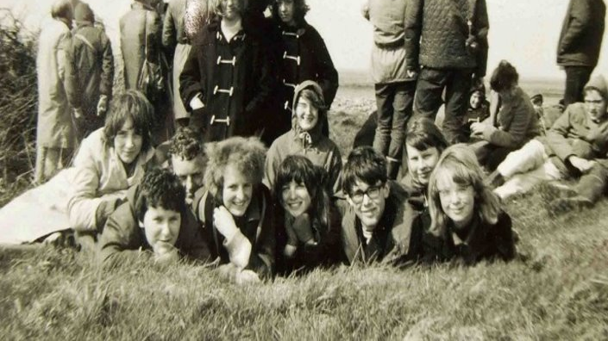
History
The main house built : 1702 to 1705 by Henry Sweating. He incorporated an older dwelling, which had been a farm.​
In 1964 the site was given to Somerset County Council to be used for the education of children.​
​
It opened in 1965 with residential places for 26 students along with four staff.​
​
Since then, we have grown and have over 200 beds across Kilve & ODC with lots of office, hospitality, instructor & maintenance staff.

Slide 6
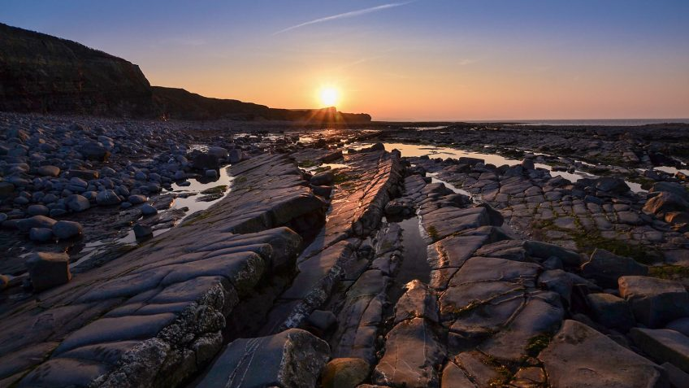
Why go on residential?
Enjoyment ​
Personal Achievement​
Confidence​
Social Awareness​
Environmental Awareness​
Life long Memories​
Health and Fitness​
Increased Motivation​
Mental wellbeing
Broadened Horizons​
Team Cohesion ​
Adventure​
Personal Responsibility ​

Slide 7
Security & Policies
To operate safely and efficiently, we …​
AALA license (Adventurous Activities Licensing Authority) ​
All staff are DBS checked​
NGB qualified staff (National Governing Body)​
Risk assessments & procedures for all activities, ​ grounds & buildings​
All corridors, and the main front door have keypad entry systems​
There are security cameras around the premises and internal corridors
Centre staff identified with uniforms​

Slide 8
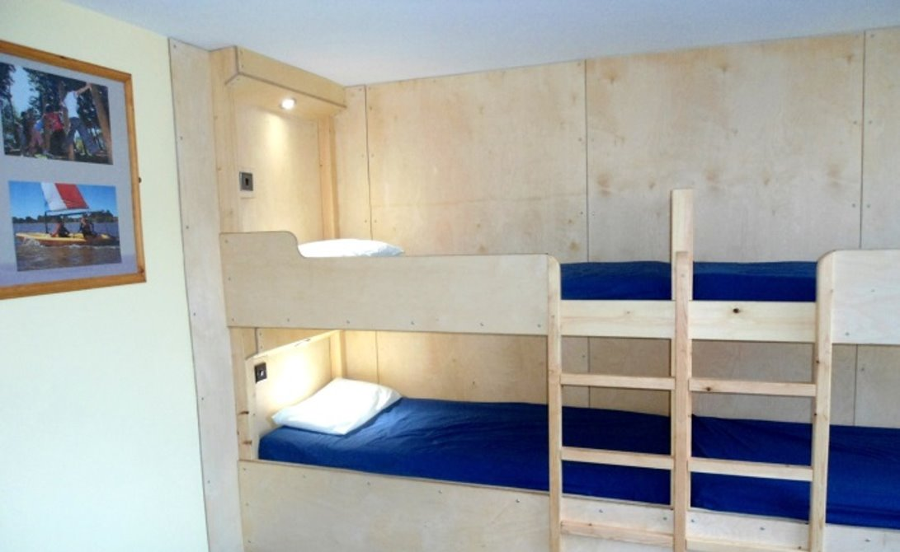
accommodation
Room sizes vary from 2-12
All rooms have their own sinks & mirrors
There are showers & toilets on each floor
Separate staff accommodation & bathrooms on each floor
Smoke detectors in each room, corridors and main areas
Linked to an emergency response centre
Keypad entry to all accommodation blocks

Slide 9
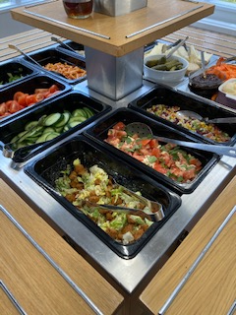
The most important bit…food!
BREAKFAST - A choice of cereal, followed by a cooked breakfast, with fruit juice & toast​
LUNCH - A choice of 2 cooked meals, jacket potatoes, filled rolls and a fresh salad bar. Fruit for dessert​​
DINNER - 2 choices, one of which is vegetarian, a salad bar and a yummy pudding! ​
BREAK TIMES - Squash, biscuits, fruit or cake ​
We accommodate all dietary requirements – ​we just need to know these in advance.​
Everyone is catered for, always.​

Slide 10
Activities
ABSEIL TOWER​
SHELTER BUILDING​
CAMP FIRE​
BUSHCRAFT​
COMPASS COURSE​
ARCHERY​
JUMBLIES​
LOW ROPES COURSE​
GRASS SLEDGING​
FRISBEE GOLF​
MOUNTAIN BIKING​
NIGHT WALK​
CLIMBING WALL​
TEAM CHALLENGES​
POND STUDY
RIFLE SHOOTING​
BEACH VISIT​
ENVIRONMENTAL ART​
HIGH ROPES COURSE​
SUP
BUGGY BUILDING​
MAZE​
KAYAKING
CAVING
RAFT BUILDING
ROCKET BUILDING

Slide 11
A typical day
ARRIVAL DAY ​
Arrive, unpack, settle in, welcome talk and a fire drill. ​
DURING YOUR STAY ​
Wake up around 7:45am, breakfast is at 8:30am, morning activities, lunch, afternoon activities, evening meal, evening activities, bedtime. There are break times in the morning and afternoon.​
DEPARTURE DAY ​
Wake up and pack, move bags to your designated room, ​breakfast, last activity, lunch, goodbyes and depart.​

Slide 12
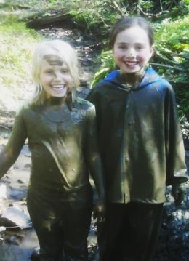
Helpful packing tips
Please involve your child in packing their own suitcase – this way they will know what they own when packing to come home​​
Put names in clothes & footwear – really helps when items get mixed up​​
Only pack clothes that are ok to get wet & muddy – children get upset if they get new clothes dirty, thinking that they will be in trouble​​
Do not pack any electrical items – they may get broken​
lip balm, sunscreen, drinks bottle, book, pocket money, torch &​cuddly toy – all recommended items to pack too. ​​
A black bin bag – to put wet muddy clothes in
A detailed kit list will be issued from your school.​

Slide 13
Thank you for your time
Any questions?

